Slide 1
Impact Mapping How to Make Value-Driven Prioritization a Reality
AgileWorks
Tim guay, PMP, pmi-acp, cSM, csp
www.agileworksinc.com
tim@agileworksinc.com
AgileWorks Copyright 2017

Slide 2
Objectives
Get an overview of how to construct an Impact Map with your stakeholders in a structured brainstorming session.
Interpret the map to derive epics/user stories, metrics and testable hypotheses.
Build a sample map yourself
AgileWorks Copyright 2017

Slide 3
Tim Guay, Agile Coach and Trainer
Agile Practitioner since 2002
PMP, CSM, CSP, PMI-ACP, etc.
Clients include; JP Morgan Chase, Citigroup, Accenture, Cisco, Intuit, State of Washington, and the Royal Canadian Navy ( to name a few).
AgileWorks Copyright 2017

Slide 4
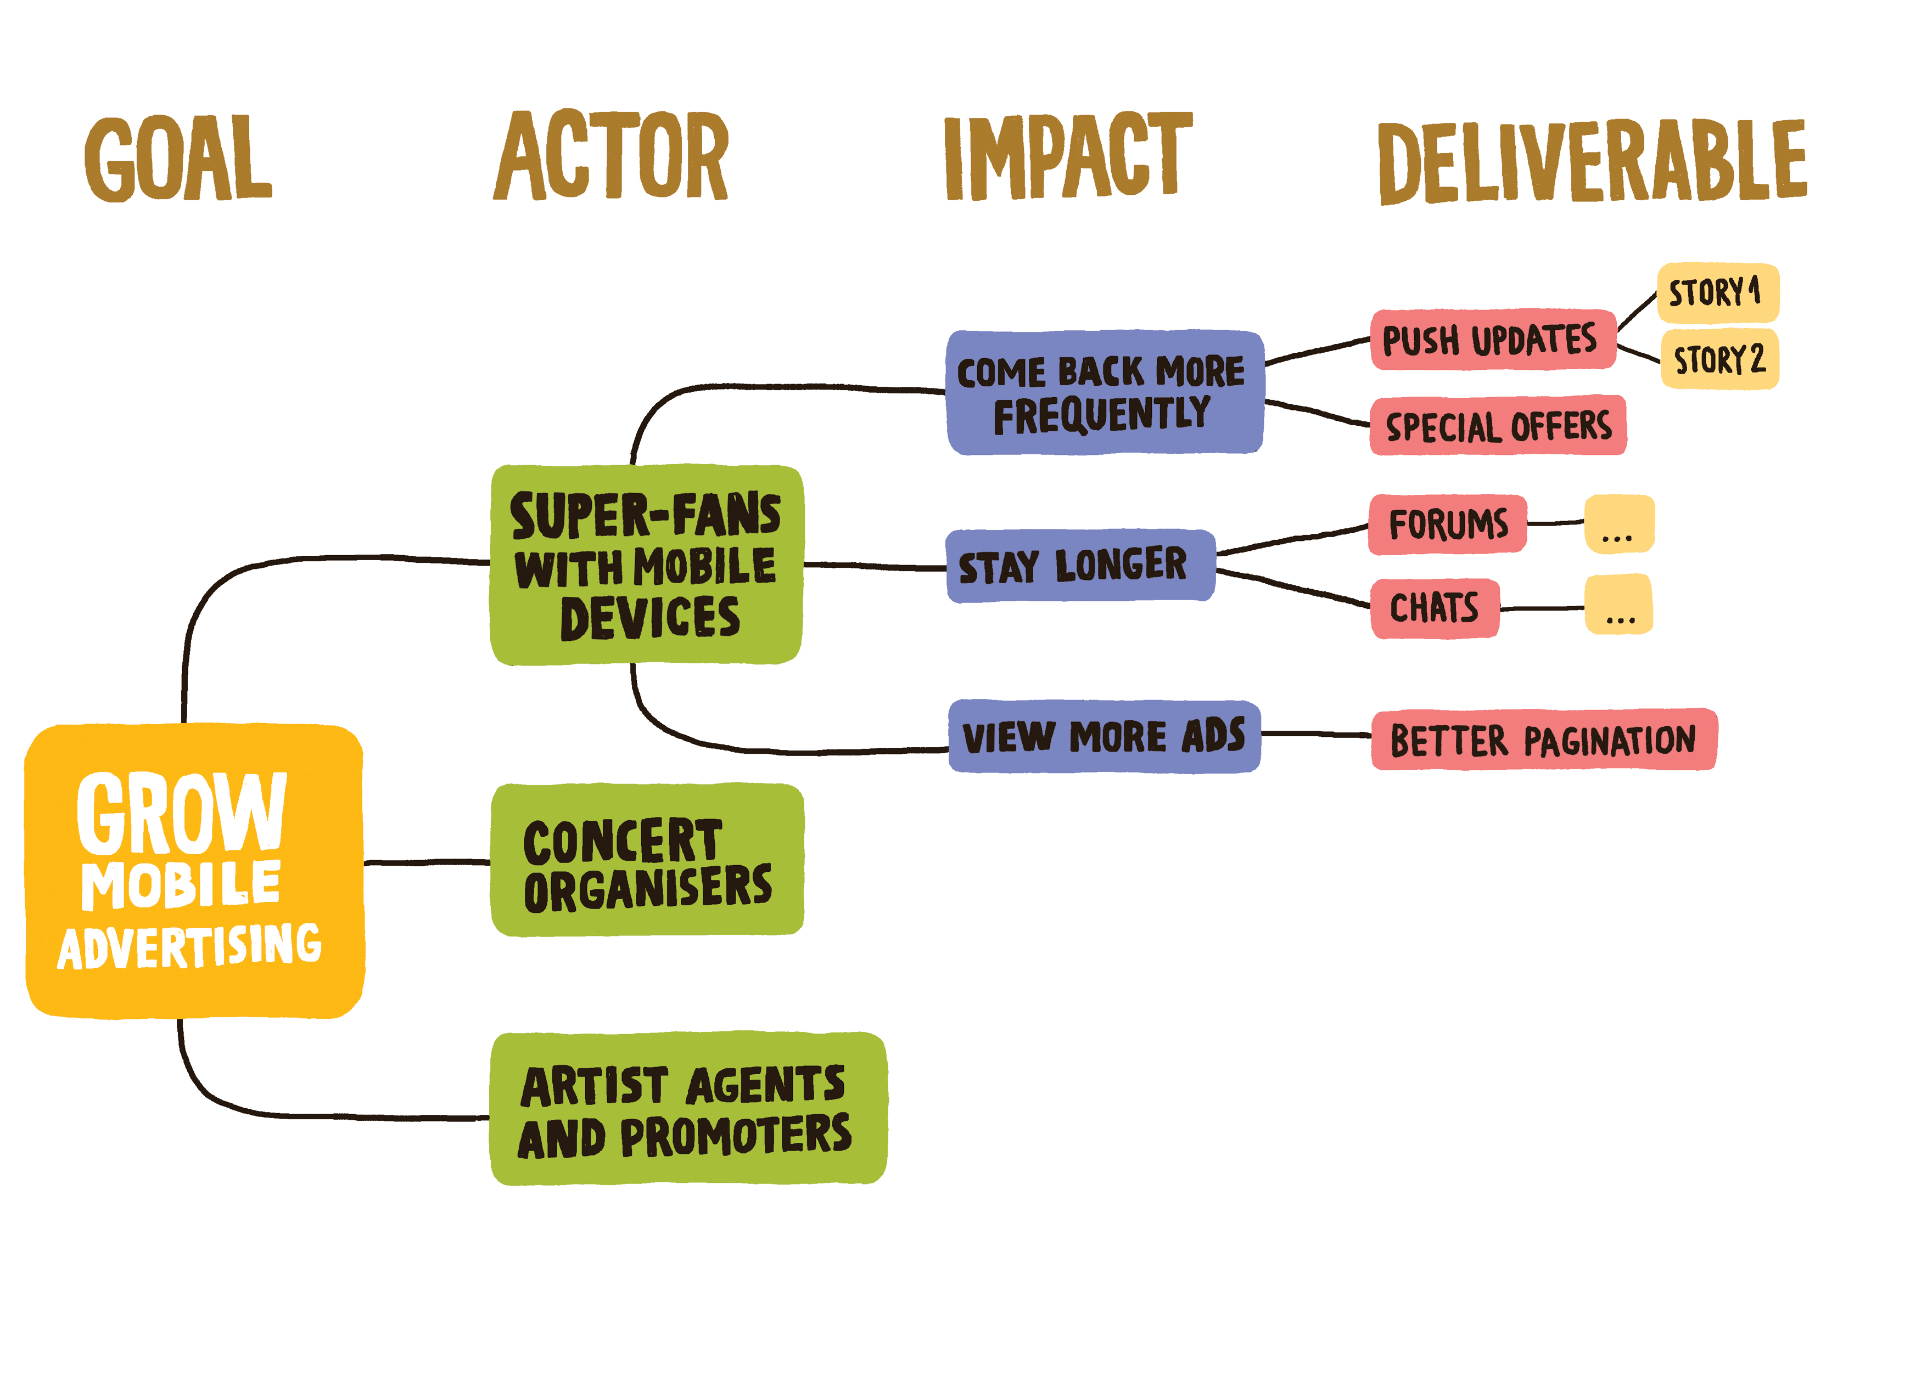
What is an Impact Map
A low-fidelity visual tool for project decision-making
Used by both stakeholders and the team to
Define the goal
Identify assumptions
Identify impacts
Evaluate decisions
Verify results
AgileWorks Copyright 2017

Slide 5
Why Use an Impact Map
Understanding impact(s) drives decisions
Visualizes assumptions
Facilitates collaboration between technical and non-technical folks
Adapts quickly to changes in the market or in your organization
Improves and speeds up decision-making
Integrates nicely with Agile practices
AgileWorks Copyright 2017

Slide 6
The Four W’s
Maps path from Goal to Deliverable(s)
Why = goal
Who = actors
How = impacts
What = deliverables
Why?
Who?
How?
What?
AgileWorks Copyright 2017

Slide 7
Why?
The thing we want
Always map back to our business premise and strategy
Goal should be SMART
Specific
Measureable
Assignable
Realistic
Time-bound
AgileWorks Copyright 2017

Slide 8
Who?
Who can help us reach our goal?
Who can obstruct it?
Whose behavior do we want to impact?
Three types
Primary – Their goals are fulfilled or stymied by our work
Secondary – Support or hinder our work
Tertiary – Has an interest, but not directly impacted or impacting
AgileWorks Copyright 2017

Slide 9
How?
How could our actors’ behavior change in a way that supports our goal?
What new behaviors would best help us achieve our goals?
What existing behaviors impede our goal?
Focus only on relevant behaviors!
AgileWorks Copyright 2017

Slide 10
What?
What can we do or create to support the desired change?
Trace back up the chain to tie into the why
Make sure its measurable
Initially deliver a MVP or MVS
Validate
Persist or pivot
AgileWorks Copyright 2017

Slide 11
Tips for the Exercise
Be sure to consider who can hinder your goal
Meaningful metrics are key
Map only one goal
Don’t skip a level
Stay focused on the GOAL
KISS
AgileWorks Copyright 2017

Slide 12
Your Turn
We are an airline who wishes to sell tickets directly to people who are currently going through consolidators, such as Expedia
Currently we pay a 5% booking fee to the consolidators
Consolidators charge same for tickets as we do directly
But users like to shop multiple airlines to find best deal
Lets see what you come up with…
AgileWorks Copyright 2017

Slide 13
A Reminder….
AgileWorks Copyright 2017

Slide 14
We have covered our objectives
Time for
Questions and Discussion
AgileWorks Copyright 2017

